Slide 1
MindSpark
G-26
MindSpark
Dr. Syed Khaldoon Khurshid
Department of Computer Science

Slide 2
Agenda
Introduction
Problem Statement
Existing Solutions
Objectives
Literature Review
Methodology
Workflow
DataFlow
Model Implementation
System Frontend
Testing and Evaluations
Expected Results
Challenges and Risks
Conclusion

Slide 3




Introduction
Developing a generative AI model utilizing Natural Language Processing (NLP) and speech-to-text to analyze patient input and provide diagnostic suggestions aligned with DSM-5 guidelines
Addressing the mental health crisis in Pakistan, which affects millions of people yet goes untreated because to financial constraints, lack of mental health experts, societal stigma, and geographic restrictions.
Integrates advanced AI techniques like NLP and generative models with real-world data, custom AI layers, and a user-friendly interface, applying deep learning, information retrieval, and web development skills.
Our goal is to deliver quick, accurate,
and easily accessible mental health support
by developing a solution that fills in these gaps.

Slide 4
Problem Statement
Problem Definition: Mental health professionals face challenges in efficiently diagnosing and documenting psychiatric conditions due to the reliance on manual note-taking and the complexity of symptom analysis. In countries like Pakistan, limited access to mental health services, societal stigma, and a shortage of psychiatrists further exacerbate the problem, leading to delayed or inaccurate diagnoses.
Significance: The stigma and lack of access to timely assistance for mental health illnesses are major concerns in Pakistan. Private, easily available evaluations are provided by an AI diagnostic tool, facilitating early identification and action.

Slide 5




Existing Solutions/Limitations
There exist AI-based Health tools like “Babylon Health” and “Ada check your health”.
PREDICTIONS
TECHNOLOGIES
DISEASES
GENERATIVE AI SOLUTIONS
Lacks the accuracy where multiple symptoms overlaps using Deep Learning Models such as CNN, RNN
Lack of NLP models that are used for text analysis and document summarization
Limited to physical health conditions and lack treatment plans and recommendations.
Use of Deep Learning models like generative adversarial networks (GANS) to create synthetic data that mimics real patient data

Slide 6






Objectives
NLP & SPEECH-TO-TEXT
AI-POWERED DIAGNOSTIC TOOL
A generative AI model trained on DSM-5 guidelines to analyze patient input and provide potential diagnoses.
Capabilities to understand and process both written and spoken patient inputs.
DETAILED REPORTS
INTERATIVE INTERFACE
Automatic generation of comprehensive diagnostic reports in PDF or other formats.
A web or mobile application for patients to input data and receive diagnostic suggestions.
PROFESSIONAL DASHBOARD
RESEARCH PAPER
An interface for healthcare professionals to review, interact with, and validate AI-generated diagnoses.
In addition to developing the diagnostic tool,
we aim to publish a research paper
detailing our methodology, findings, and the impact of DSM-5 alignment on
AI-driven mental health diagnostics.

Slide 7
Literature Review
The research papers highlight the role of AI and machine learning in mental health diagnostics, their potential to improve accuracy and personalize treatment. They also discuss challenges such as the need for data privacy concerns and integration into clinics. Chatgpt and similar AI models like Gemini provide general information and guidance but lack real-time diagnostic capabilities and personalized interactions.
In contrast, our project will advance this field by integrating DSM-5 guidelines into a real-time, AI-driven diagnostic tool, utilizing Gen AI and NLP technologies for comprehensive and personalized diagnostics. It aims to contribute to academic knowledge through a detailed research paper.

Slide 8
Proposed Solution/Methodology
Planning Phase
Define Objectives and Scope
Gather Requirements
Design Phase
Conceptual Design
Technical Design
Implementation Phase
Set Up Development Environment
Risk Assessment
Project Timeline and Milestones
NLP Component Design
Speech-to-Text Component Design
User Interface and Experience (UI/UX) Design
Testing Phase
Develop NLP Module
Develop Speech-to-Text Module
Implement Security Features
Unit Testing
Integration Testing
Performance Testing
Security Testing
Deployment Phase
Prepare Deployment Plan
Set Up Production Environment
Deploy Application
Post-Deployment Testing
Continuous Monitoring
Backend Development
Frontend Development
Analysis Stage
Implement Stage
Project Management

Slide 9
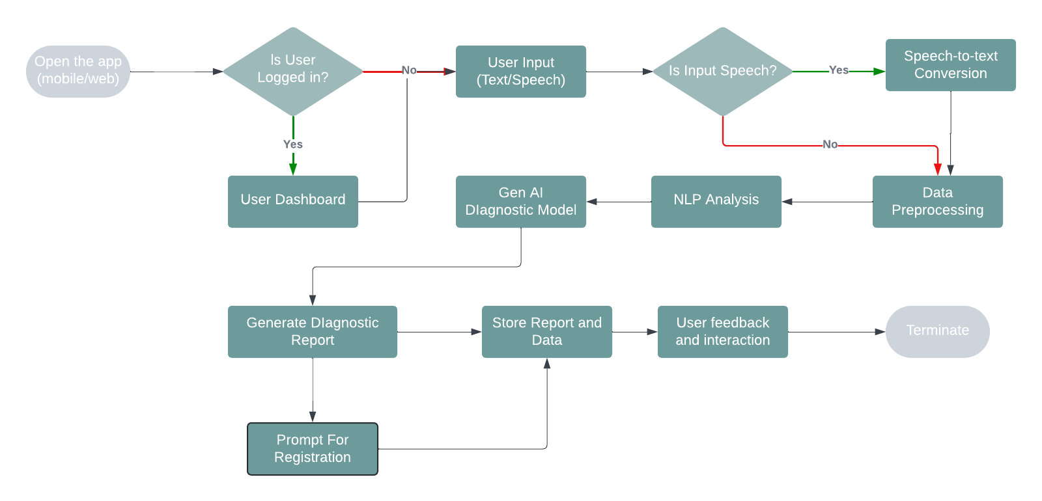
Workflow

Slide 10
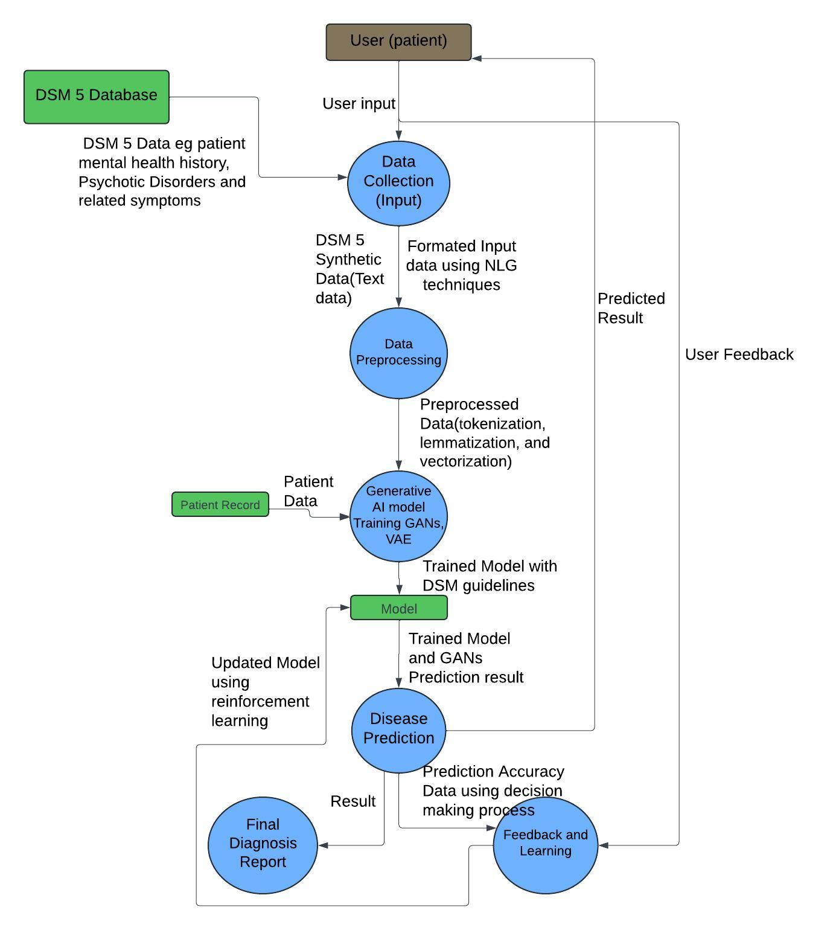
System Design
DFD Diagram

Slide 11
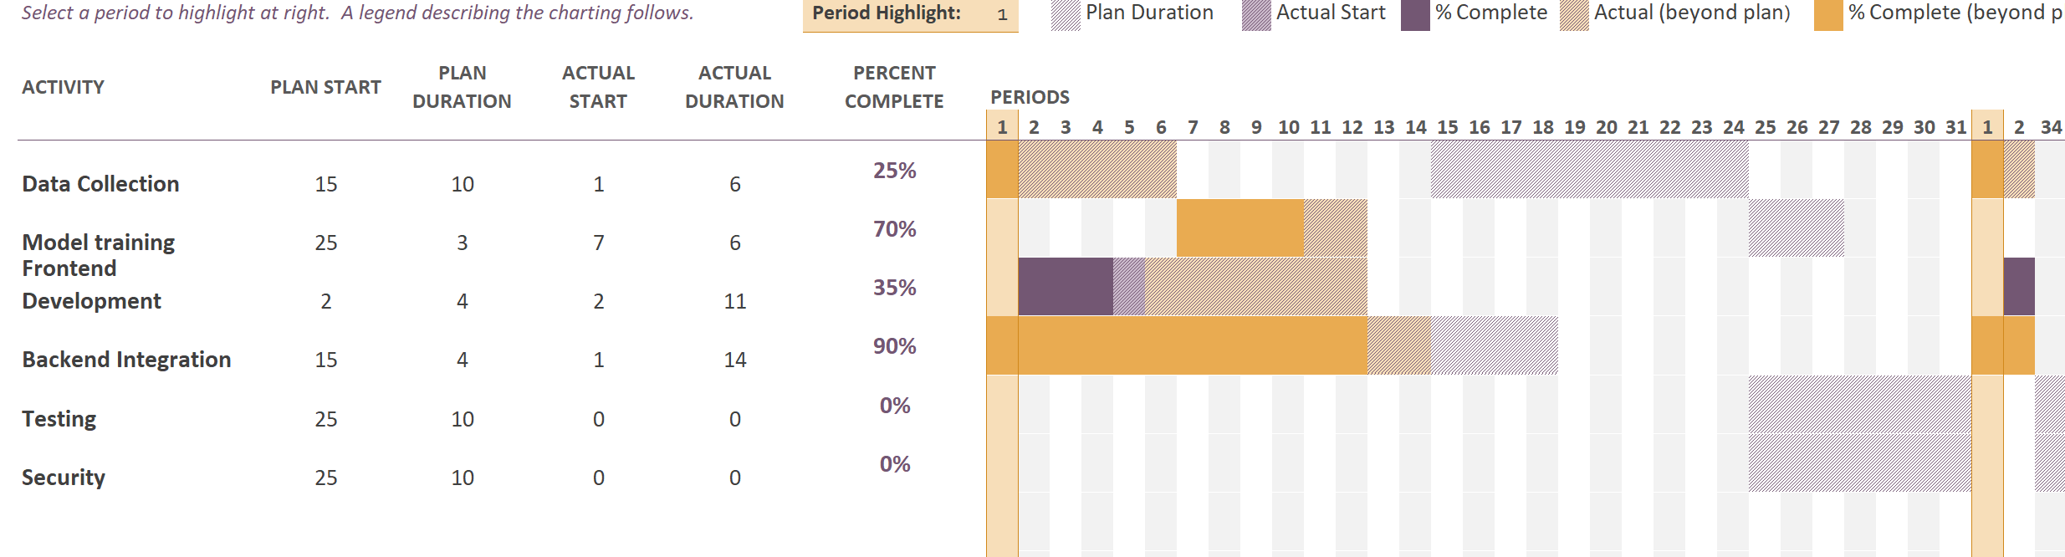
Implementation Plan
Gantt Chart

Slide 12
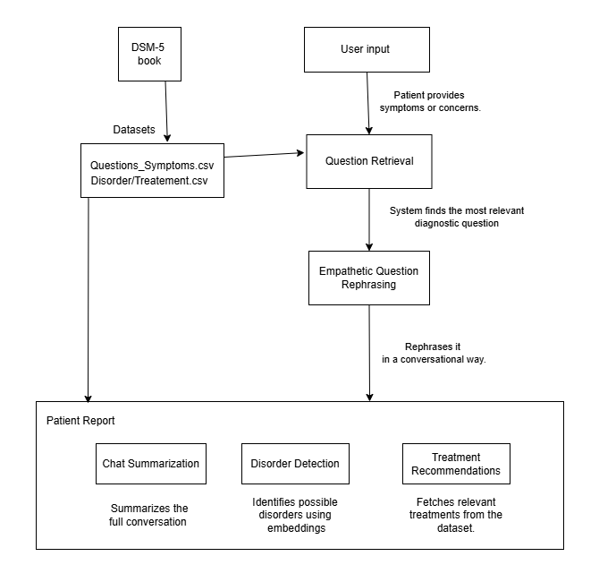
Model Implementation
Approaches Simple RAG, Deepseek, Hybrid RAG

Slide 13
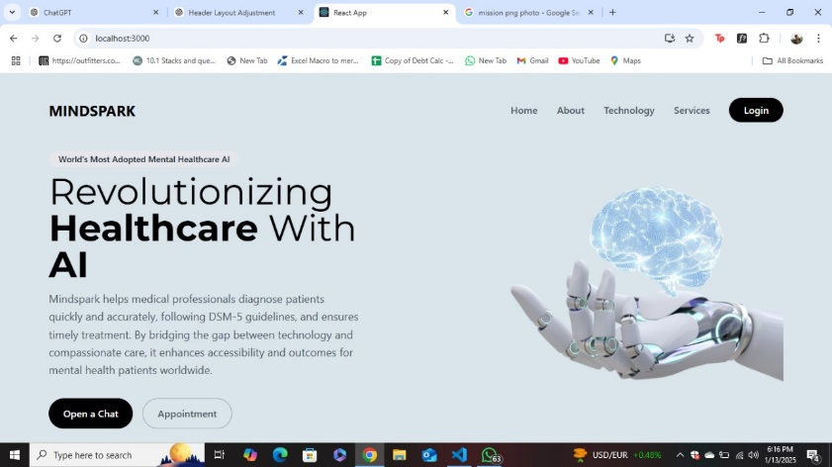
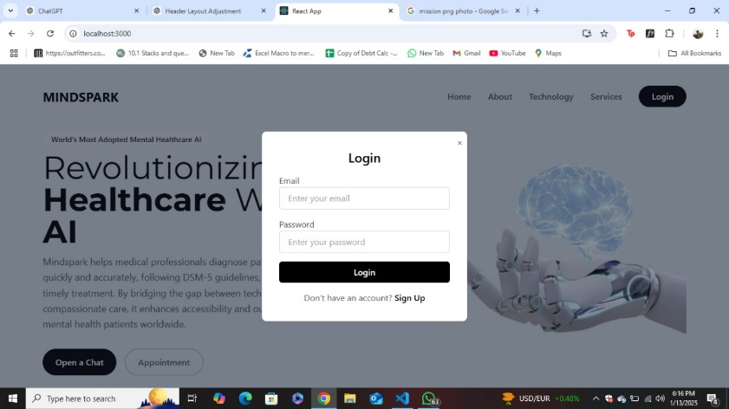
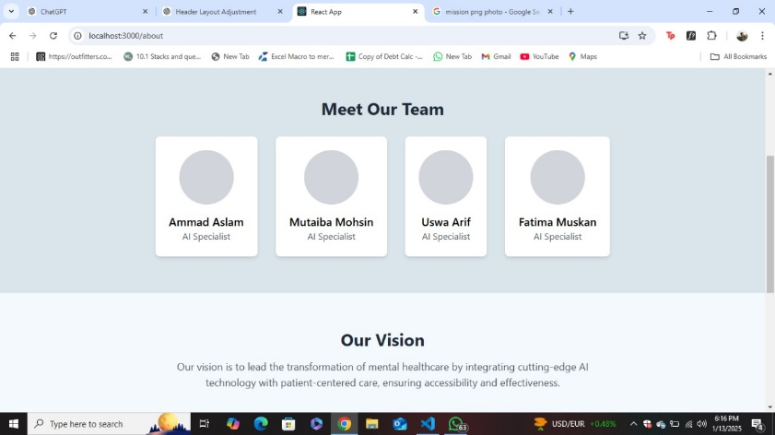
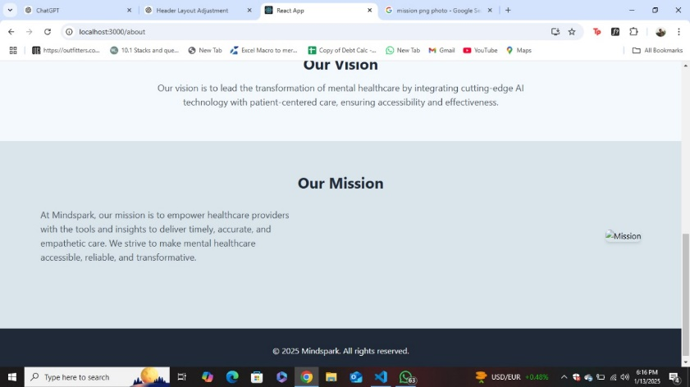
System Frontend
Uses React, Tailwind CSS

Slide 14
Testing and Evaluation
GenAI Evaluation Metrics
Coherence score, alignment with DSM-5 and BLEU score
(quality of the generated text against referenced text)
GenAI Model testing
Test the Generative AI model (like GPT) for accuracy in understanding patient input, coherence in generated responses, and alignment with DSM-5 guidelines.
Precision and Recall
Evaluate the balance between correctly identified diagnoses and missed or false suggestions.
Integration testing
Test how different components (e.g., speech-to-text, NLP, DSM-5 mapping) work together to ensure seamless interaction..
Response time
Track the time taken by the AI to analyze input and generate a diagnosis.
User Acceptance testing
Involve end-users (patients, clinicians) to evaluate usability, clarity, and overall effectiveness of the system...
F1-score
Calculate the harmonic mean of precision and recall to assess overall performance. It signifies that the model can effectively identify positive cases while minimizing false positives and false negatives.

Slide 15


Expected Results
Anticipated Outcomes
Improved accuracy in mental health diagnosis
User-friendly interface for healthcare professionals and patients
Comprehensive Gen AI-driven reports
Potential Impact
Expanding mental health services accessibility
Reducing the diagnostic time and improving patient outcomes
Empowering healthcare professionals with Generative AI support

Slide 16
Challenges and Risks
Challenges
Solutions
Risk of sensitive patient data breaches.
Implement strong encryption, secure storage, and data anonymization.
Potential biases in AI model predictions.
Regular auditing and diverse dataset training to mitigate bias.
Our focus is on minimizing hardware requirements by developing compact LLM GenAI models
Hardware Requirements

Slide 17
Conclusion
Address Gap: Overcome mental health diagnostic barriers in regions like Pakistan.
AI-Powered Tool: Provide accessible and confidential diagnostics using DSM-5.
Enhanced Accessibility: Use NLP and speech-to-text for diverse patient inputs.
Research Publication: Submit a research paper detailing the methodology, results, and impact of using AI in mental health diagnostics.
Expansion and Enhancement: Develop additional features, such as multilingual support and integration with telemedicine services.

Slide 18
References
https://www.ncbi.nlm.nih.gov/pmc/articles/PMC7364393/
https://www.ncbi.nlm.nih.gov/pmc/articles/PMC7358693/
https://ada.com/
https://emed.com/uk

Slide 19
Q&A
Open the floor for questions from the audience

